Slide 1
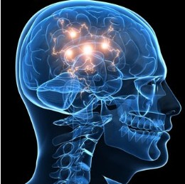
Statistical Approaches to Examining Cognitive Ability in Multiple Sclerosis Patients
Annie Bathen
Nicole LaPointe Jameson
Fangfei Lan
Kyle Rehr
Sajala Shukla
Jingyi Wang
Elizabeth Wang
Notes:
A

Slide 2
Outline
Background on Diffusion Tensor Imaging
Data Cleaning
PASAT Resolution
Exploratory Analysis
Model Fitting
Final Model Results
Appendix and Acknowledgements
Notes:
A

Slide 3
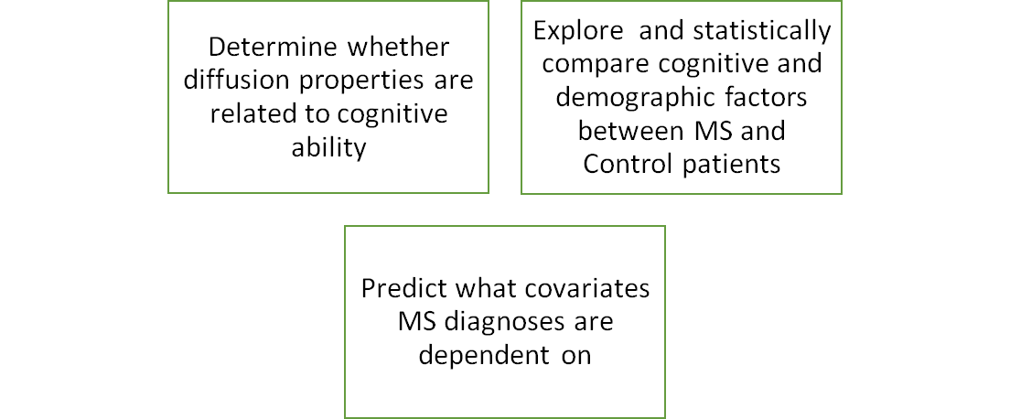
Background and Goals
Notes:
A

Slide 4
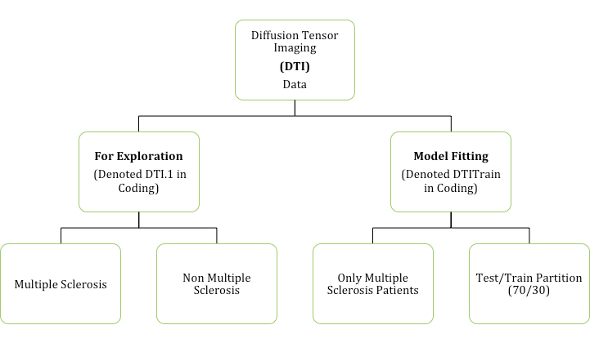
Data Partitioning
DTI data was collected at Johns Hopkins University and the Kennedy-Krieger Institute: 340 MS subjects and 42 controls
Notes:
N

Slide 5
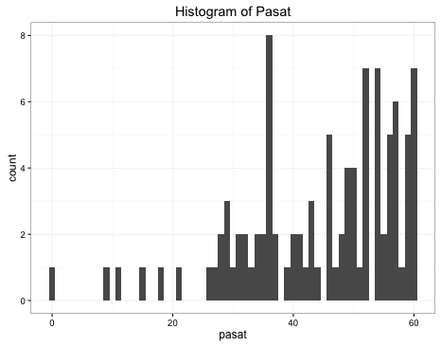
Paced Auditory Serial Addition Test (PASAT)
Measure of cognitive function:
Assesses auditory information processing speed
Calculation ability
Notes:
S

Slide 6
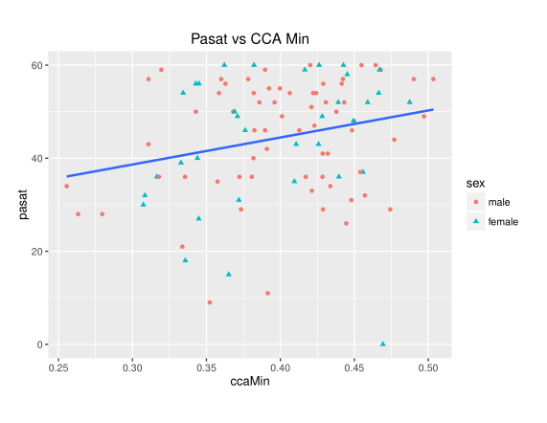
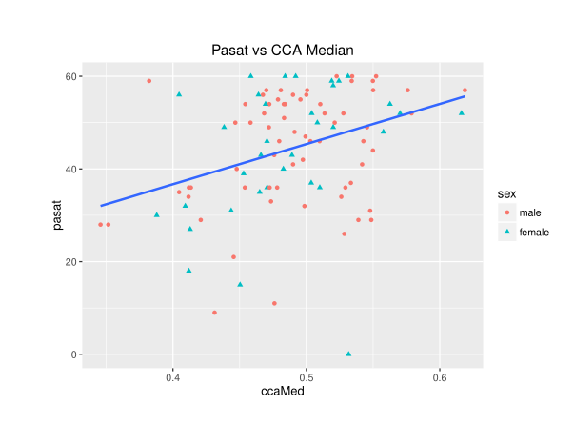
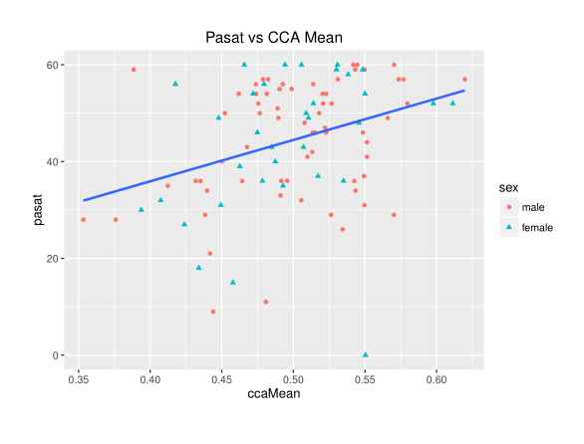
PASAT Score by
Aggregated Metrics
Notes:
S

Slide 7
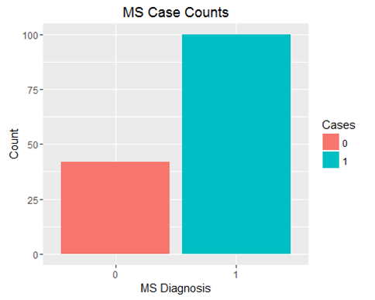
Case
Case indicates diagnosis with MS (0 is no MS, 1 is MS)
Slightly unbalanced binary response
Proportion of Sample Population with MS: 100/142 = 70.4%
Notes:
A

Slide 8
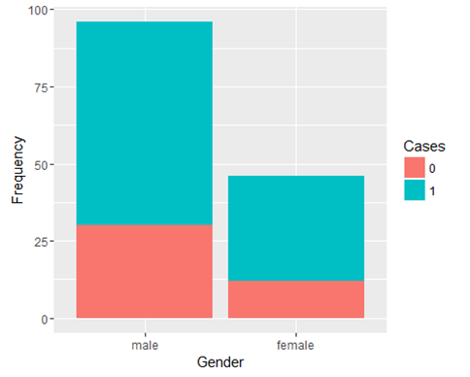
Gender Tests of Significance
p = proportion of respective genders with MS
Hypothesis Testing
H_{o} : p₁ = p₂
H_{a} : p₁ ≠ p₂
Independent Proportion Test
p-value = 0.7357
Chi-squared Test of Independence
p-value = 0.5281
Conditions are not perfectly met
Fail to reject H_{o}
Notes:
A

Slide 9
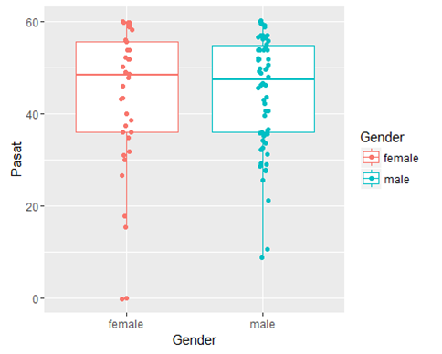
Gender and PASAT
μ = mean PASAT score with respective gender
Hypothesis Testing
H_{o} : μ₁ = μ₂
H_{a} : μ₁ ≠ μ₂
Wilcoxon rank sum test
p-value = 0.8842
Fail to reject H_{o}
There were no statistically significant differences between gender and other covariates.
Notes:
A

Slide 10
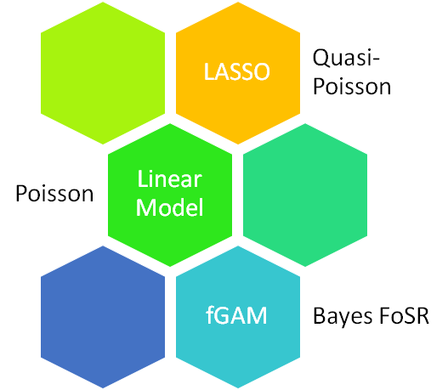
Model Fitting
Notes:
S

Slide 11
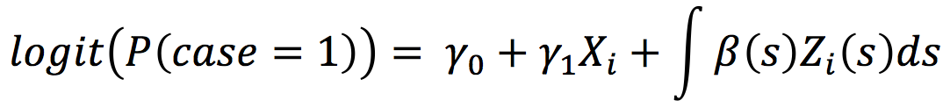
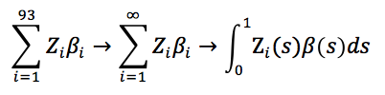

Functional Generalized
Additive Model
Why penalized functional regression?
"Penalized Functional Regression" Goldsmith, J. JCGS(2011)
Uncontrollable/continuous points
93 observations are only observed as samples
II. Form:
III. Assumptions:
Notes:
S *****

Slide 12
Model Explanation
The fitted model:
Function:
fgam with FLM regression term (lf)
The involved tests:
Z-score test for intercept
Z-score test for sex
Generalized Chi-squared test for smooth terms
Notes:
S ****

Slide 13
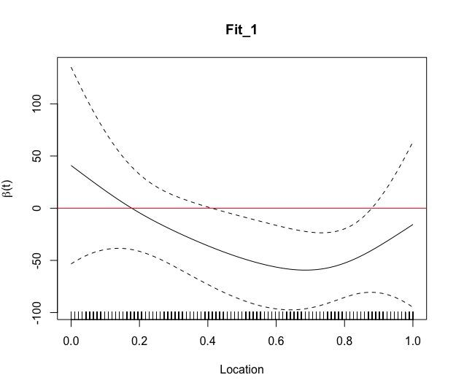
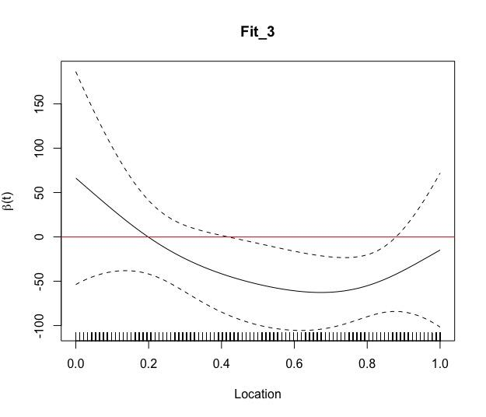
FGAM Results
Fits based on spline values and smoothing parameters
Similar fit output between models
Non-significant: sex/specific location CCA
Notes:
S

Slide 14
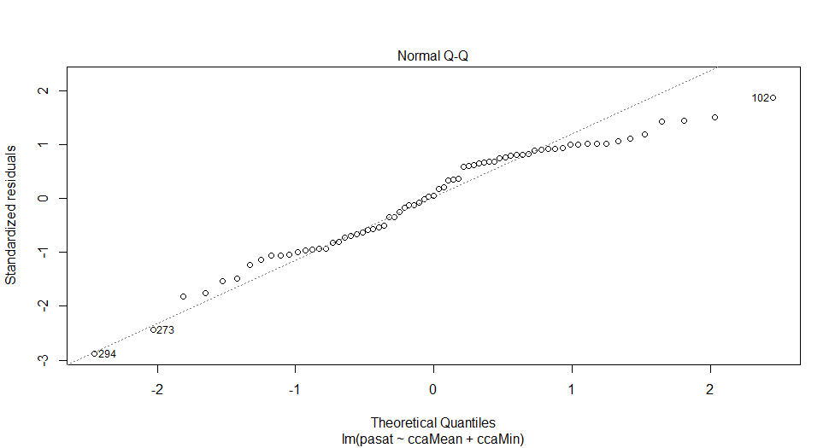
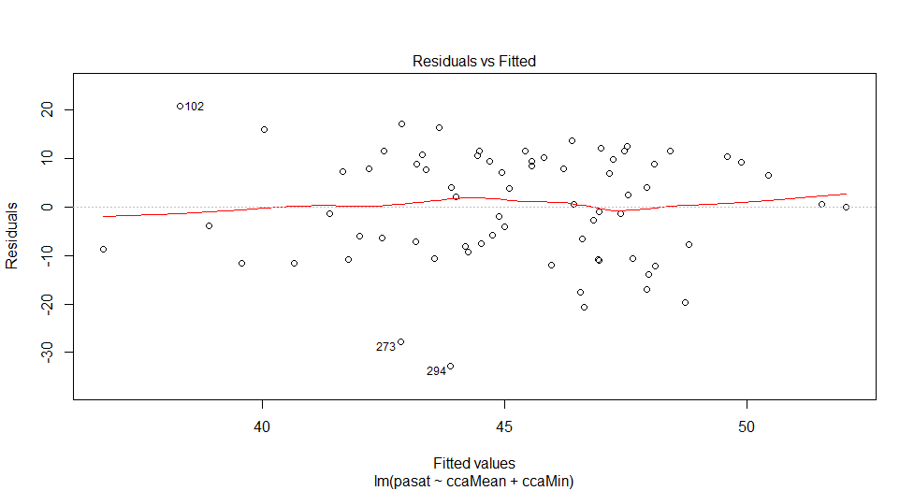
Basic Linear Model:
Multiple Linear Regression
Ŷ=15.49+94.78ccaMean-43.87ccaMinimum
Assumptions
Linear Relationship
Multivariate Normality
Predictor P-Values:
Cca Mean p-value= 0.072
Cca Min p-value=0.376
Intercept significant
Notes:
N

Slide 15
Least Absolute Shrinkage and Selection Operator
Intuition:
Automatic Feature Selection
Robust
Assumptions:
Conditionally independent gaussian residuals
Zero mean and constant variance
Normalized Covariates
III. After Training:
Lambda set to .08136
Null Deviance Explained was 23.22% (on 2 df)
IV. Poor Performance Due To:
Broken assumptions
Susceptible to correlation/ noise
Notes:
N

Slide 16
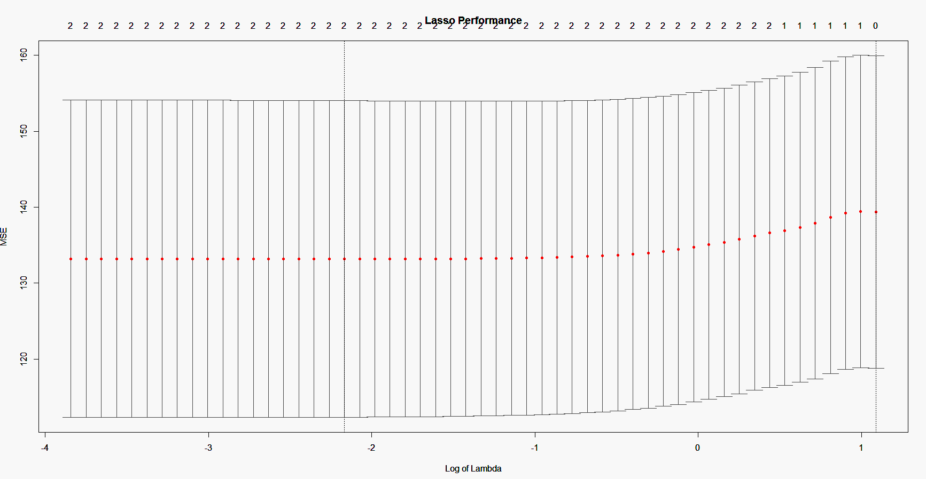
Lasso Results
Notes:
N

Slide 17
Poisson
Model 1 | Model 2 | Model 3
log(μ)= 3.16 + 1.25ccaMean + 0.08sex | log(μ) = 3.16 + 1.28ccaMedian + 0.07sex | log(μ) = 3.50 + 0.71ccaMinimum + 0.08sex
Overdispersion Parameter: 3.23 | Overdispersion Parameter : 3.21 | Overdispersion Parameter: 3.34
Goodness of Fit Test: P close to 0 | Goodness of Fit Test: P close to 0 | Goodness of Fit Test: P close to 0
Reject all H_{o}’s; the Poisson models do not fit the data
Notes:
N

Slide 18
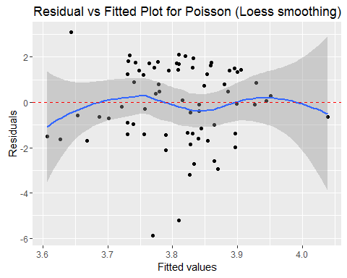
Quasi-Poisson
T-test for significance of parameters
ccaMean: significant
ccaMed: significant
ccaMin: not significant
sex: not significant
Notes:
N

Slide 19
Function-on-Scalar Regression: Keep it Functional!
III. Bayesian FoSR:
Incorporates priors to aid in prediction
For real-values response curves
Estimate residual curve with Bayesian FPCA
Estimate model parameters with Gibbs Sampler
IV. Component of DTI:
CCA along the 93 axon tract locations
Functional Data?
Multivariate data with ordering on the dimensions. (Müller,2006)
Functional Responses and scalar predictors
Function on Scalar Regression:
Generalized multilevel functional response
Notes:
N

Slide 20
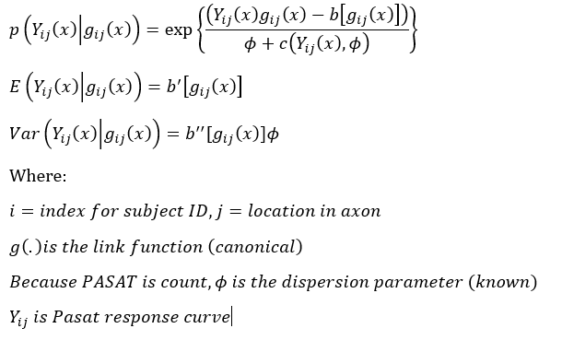
The Model and Assumptions
Model Formula:
II. Assumptions:
FPCA
Parsimonious function of eigenbasis
Correct order
Avoids unreasonable assumptions of posterior independence and provides joint inference that has been shown to have good numerical properties (Goldsmith, 2014).
Gibbs Sampling
Samples approximate joint distribution
Expectation is approximated by averaging across samples
Notes:
N

Slide 21
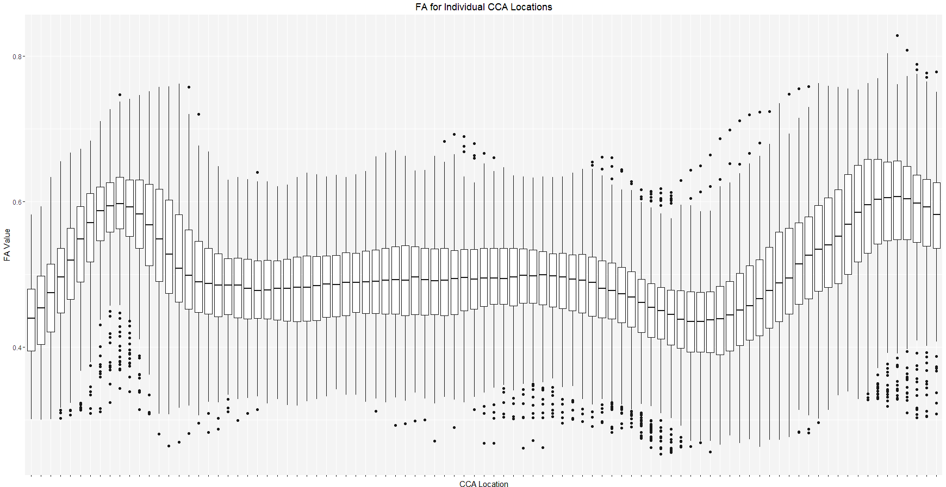
Breaking Down the Functional CCA Values
FA for Individual CCA Locations
Notes:
N

Slide 22
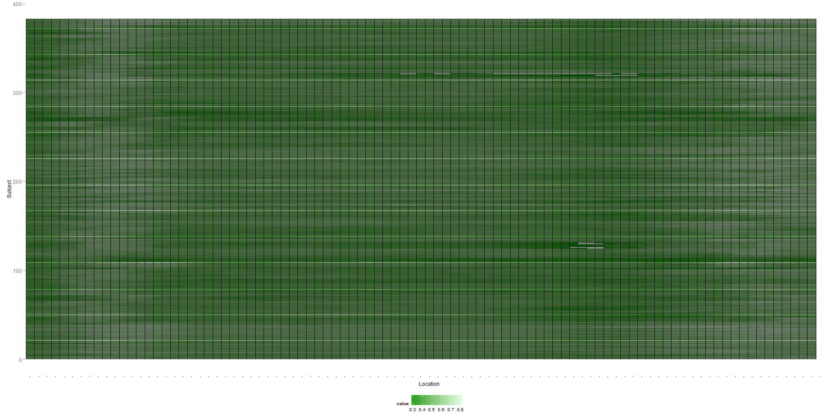
.... An Alternative Display
CCA FA Values Plot Across Location
Notes:
N

Slide 23
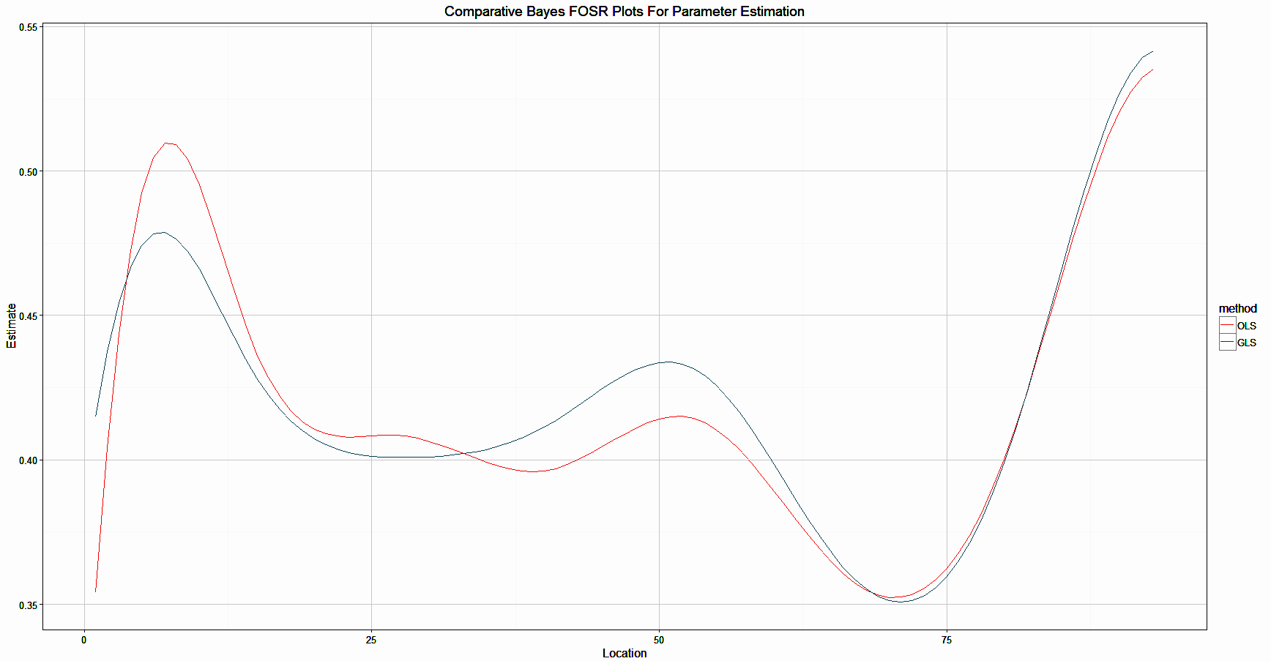
Bayes FoSR Results
Comparative Bayes FoSR Curves for Parameter Estimation
Notes:
N

Slide 24
Conclusions
For best inference and prediction, keep the data functional
Bayesian Models best address inherent relationships
For moving forward:
Start at base data:
Record all PASAT Values
Address missing FA values (RCST and CCA)
Complete and larger patient data to mimic the true expected FA curves
Notes:
A

Slide 25
Appendix
"LASSO Assumptions." CrossValidated. 25 Jan. 2011. Web. 26 May 2016. <http://stats.stackexchange.com/questions/6502/lasso-assumptions>.
Risk, Benjamin. SAMSI Undergraduate Workshop: Statistical Modeling of DTI Data. SAMSI, 23 May 2016. Web.
Zhang, Zhengwu, and Benjamin Risk. Statistical Modeling of Diffusion Tensor Imaging. SAMSI, 23 May 2016. Web. 23 May 2016.
Crainiceanu, C. M., Staicu, A.-M., Ray, S., and Punjabi, N. (2012). Bootstrap-based inference on the diﬀerence in the means of two correlated functional processes. Statistics in medicine, 31(26):3223–3240.
Goldsmith, J., Crainiceanu, C. M., Caﬀo, B. S., and Reich, D. S. (2011). Penalized functional regression analysis of white-matter tract proﬁles in multiple sclerosis. NeuroImage, 57(2):431–439.
"Paced Auditory Serial Addition Test (PASAT)." Paced Auditory Serial Addition Test (PASAT). National Multiple Sclerosis Society. Web. 26 May 2016. <http://www.nationalmssociety.org/For-Professionals/Researchers/Resources-for-Researchers/Clinical-Study-Measures/Paced-Auditory-Serial-Addition-Test-(PASAT)>.

Slide 26

Thank You!

